Slide 1
IT Ticket Analysis Dashboard
Advanced Spreadsheet Analytics Project
Durnav Pattnaik
28 May 2026

Slide 2
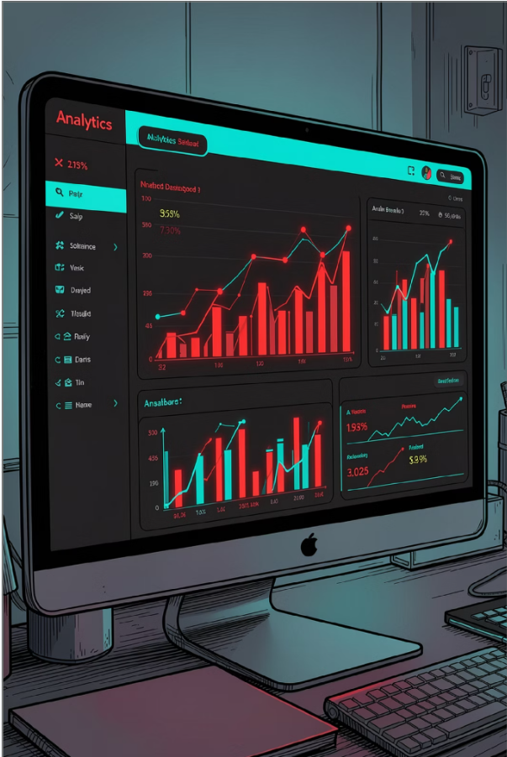
"What business challenge are we trying to solve?"
INTRODUCTION
Why This Analysis Matters
Improve ticket resolution efficiency.
Maintain high employee satisfaction.
Optimize workload distribution.
Identify operational bottlenecks.
Support data-driven investment decisions.
Problem Statement
Organizations receive thousands of IT support requests across multiple categories, severity levels, and issue types. As ticket volumes increase, it becomes difficult to maintain fast resolution times, high employee satisfaction, and efficient resource utilization.
This analysis aims to evaluate IT support performance, identify operational bottlenecks, and determine where future investments should be focused to improve service quality and operational efficiency.

Slide 3
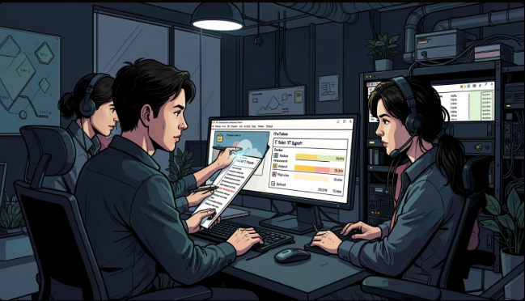
"What key questions should this analysis answer?"
PROJECT OVERVIEW
Evaluate the effectiveness of IT support operations using historical ticket data and identify opportunities to improve service quality, operational efficiency, and resource utilization.
Expected Outcome
Generate insights and recommendations that help improve service quality, operational efficiency, and strategic planning.
Key Objectives
What drives the majority of support workload?
Which request categories take the longest to resolve?
How satisfied are employees with IT support services?
Are current staffing levels sufficient?
Where should future investments be prioritized?
Understand the relationship between issue severity and resolution time.
Develop an interactive dashboard for monitoring key operational metrics.

Slide 4
"What data is available to help us answer these questions?"
Dataset Overview
Dataset Summary
The dataset contains 97,498 IT support tickets handled by 50 support agents. It includes ticket categories, issue types, severity levels, resolution performance metrics, and satisfaction ratings, providing a comprehensive view of IT support operations.
Data Fields Included
Metric
Value
Ticket ID
Employee ID
Agent ID
Request Category
Issue Type
Severity
Priority
Resolution Time
Satisfaction Rate
97,498
Total Tickets
Total Agents
50
Request Categories
4
Issue Types
2
4.55 Days
Avg Resolution Time
4.10
Avg Satisfaction

Slide 5
"Can we trust the data before performing the analysis?"
Data Quality Assessment
Why Data Quality Matters?
Before performing any analysis, the dataset was reviewed to ensure that the results would be accurate, reliable, and suitable for business decision-making.
Result: No missing values were detected in any of the analyzed fields.
Key Insight: The dataset was largely complete, with only a few spelling inconsistencies affecting category labels. These issues were corrected prior to analysis to ensure accurate reporting and visualization.
The following inconsistencies were identified:
Column | Issue | Count
Severity | Unclasified | 356
Severity | Mayor | 6,228
Priority | Unassiged | 29,410

Slide 6
"How did we prepare the data for reliable analysis?"
ACTION TAKEN
Data Preparation & Cleaning :
To ensure reliable analysis and accurate reporting, the identified data inconsistencies were corrected before performing calculations, visualizations, and dashboard development.
✅ Standardized category names to maintain consistency across records.
✅ Corrected spelling inconsistencies in Severity and Priority fields.
✅ Prepared the dataset for accurate analysis, reporting, and dashboard creation.
✅ Validated and cleaned categorical data used in pivot tables and charts.
Key Insight: The cleaned dataset provided a consistent foundation for all subsequent analysis, ensuring that business insights and recommendations were based on accurate data.

Slide 7
"How was the data transformed into actionable insights?"
Methodology
After cleaning and preparing the dataset, analytical techniques were applied to transform raw IT support data into meaningful business insights and support decision-making.
Data Preparation
Key Helper Columns Created
Validated data quality and corrected inconsistencies.
Standardized categorical fields for accurate reporting.
Enriched the dataset using lookup functions.
Created helper columns to support analysis and trend tracking.
Developed pivot tables and KPI calculations for reporting.
Agent Name
Age
Severity Numeric
Year
Month-Year
Analytical Techniques Used
Key Insight
Trend Analysis
Distribution Analysis
Comparative Analysis
KPI Evaluation
The methodology enabled the identification of workload trends, service quality patterns, operational bottlenecks, and performance opportunities, forming the foundation for the dashboard and business recommendations.

Slide 8
"What does the current state of IT support operations look like?"
Key Performance Indicators
The following KPIs provide a high-level overview of IT support operations and establish the baseline for further analysis.
TOTAL TICKETS
97498
TOTAL AGENTS
50
AVG RESOLUTION TIME
4.55 Days
AVG SATISFACTION
4.1
Key Insights:
The IT support team handled 97,498 tickets across the analysis period.
Employee satisfaction remained high at approximately 4.1/5, indicating consistent service quality.
An average resolution time of 4.55 days highlights opportunities for process and technology improvements.

Slide 9
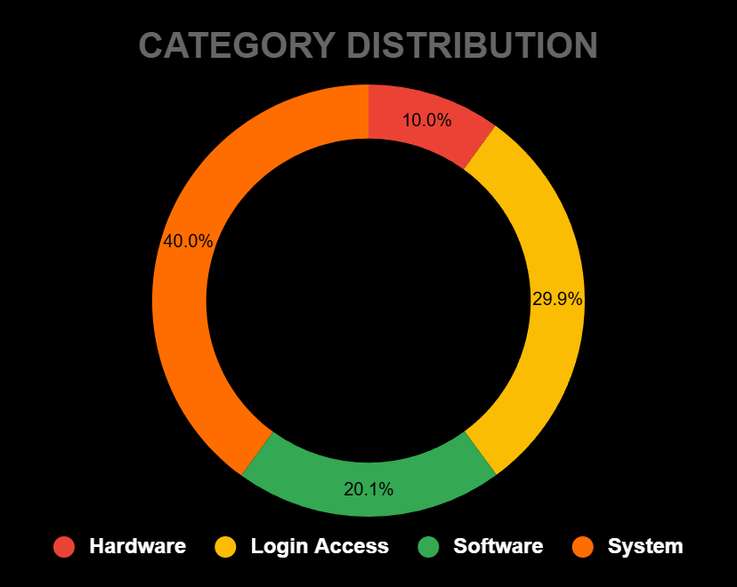
"What types of support requests are driving the workload?"
Ticket Category Distribution Analysis
Key Insights
System requests account for the largest share of tickets, representing approximately 40% of total support requests.
Login Access requests contribute nearly 30% of ticket volume, indicating frequent user access-related issues.
Hardware requests represent the smallest category, accounting for approximately 10% of all tickets.

Slide 10
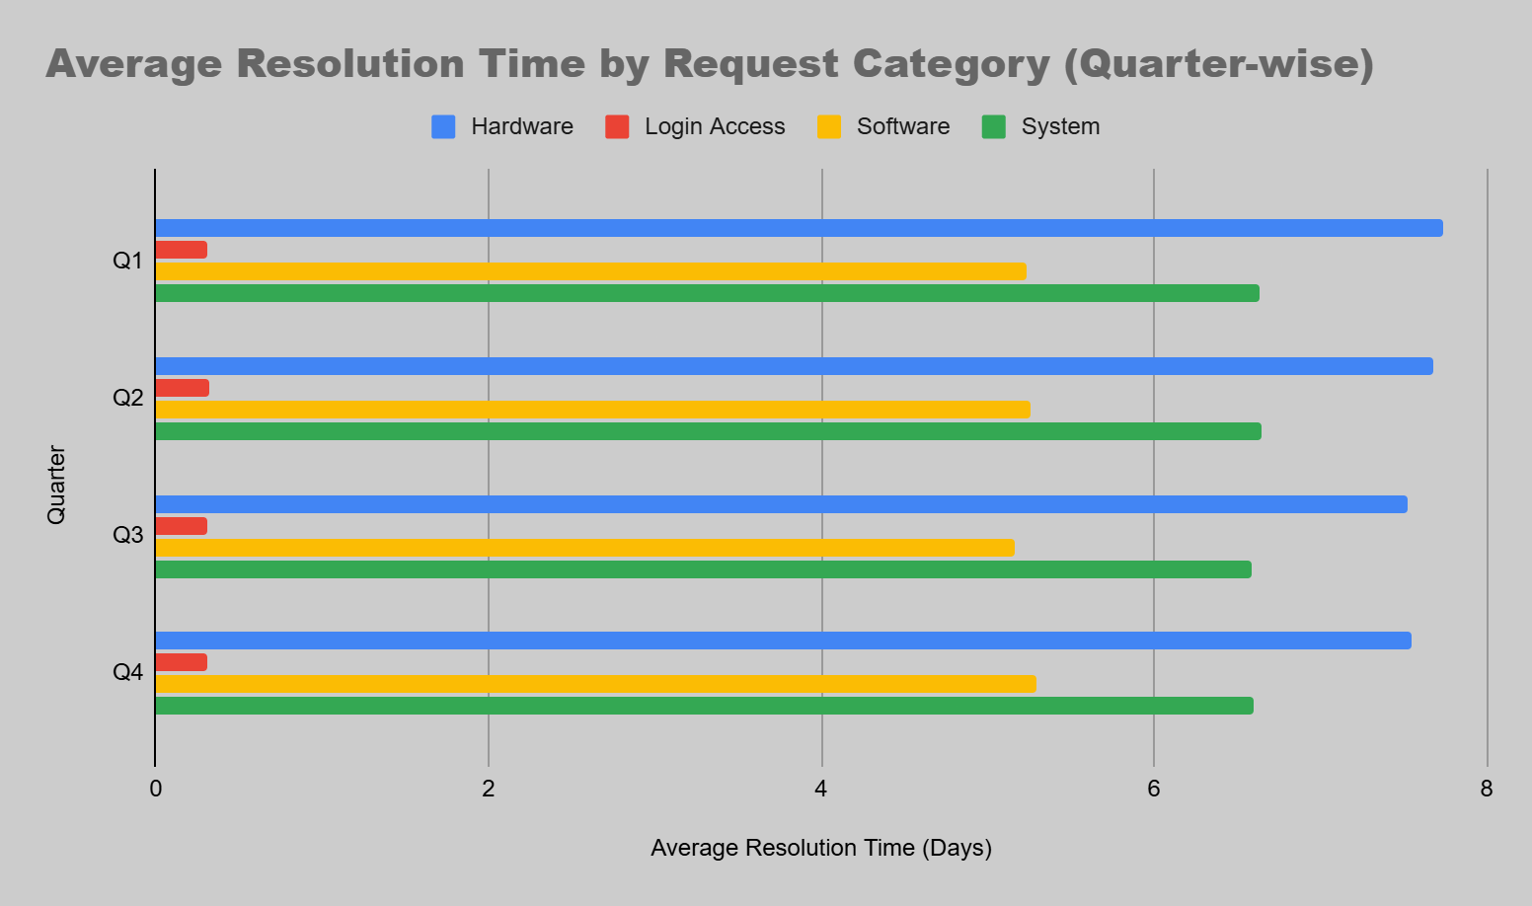
"Which request categories are causing the longest delays?"
Resolution Time Analysis - 1
Key Insights
Hardware requests consistently have the highest resolution times, averaging approximately 7.6 days across quarters.
System requests require the second-highest resolution times, averaging approximately 6.6 days.
Login Access requests are resolved rapidly, averaging less than 1 day, indicating highly efficient support processes.

Slide 11
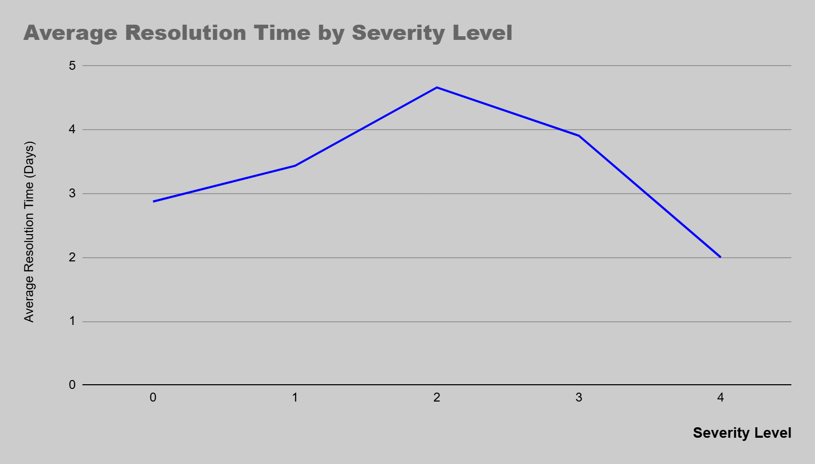
Resolution Time Analysis -2
Key Insights:
Severity Level 2 requires the highest average resolution time.
Critical issues are generally resolved faster due to prioritization.
Resolution time does not consistently increase with severity.
Business Impact:
Support teams may prioritize high-severity tickets, resulting in faster resolution despite higher urgency.

Slide 12
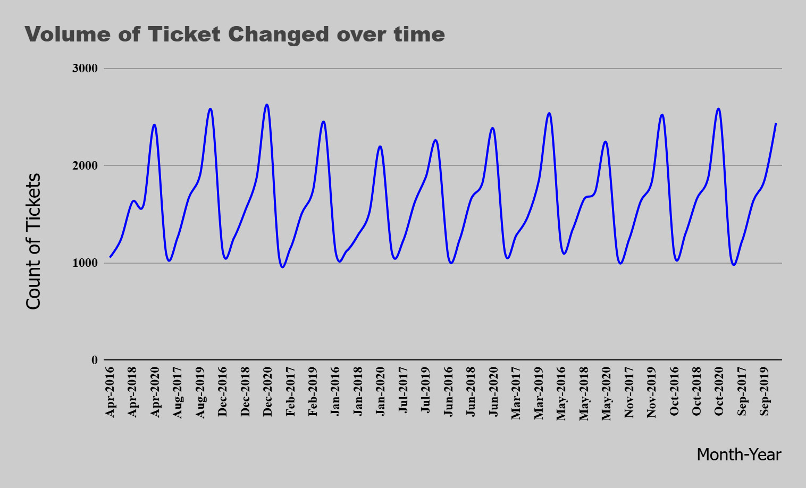
"How has demand for IT support changed over time?"
Ticket Volume Trend Analysis
Key Insights
Ticket volume increased over the analysis period.
Peak ticket volumes occurred during 2020.
Recurring fluctuations suggest cyclical workload patterns.
Business Impact : Increasing ticket volumes highlight the importance of efficient support processes, workforce planning, and technology investments to maintain service quality.

Slide 13
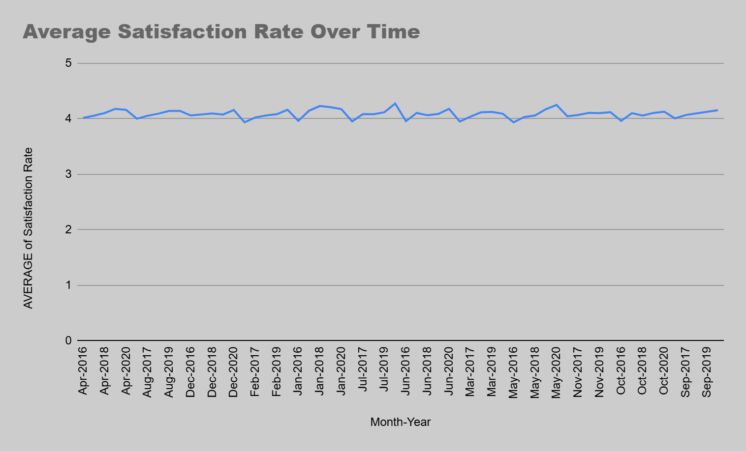
"Has service quality remained stable as ticket volumes changed?"
Customer Satisfaction Trend Analysis
Key Insights
Satisfaction remained consistently high throughout the analysis period.
Satisfaction improved gradually over time.
Increased ticket volume did not significantly reduce satisfaction levels.

Slide 14
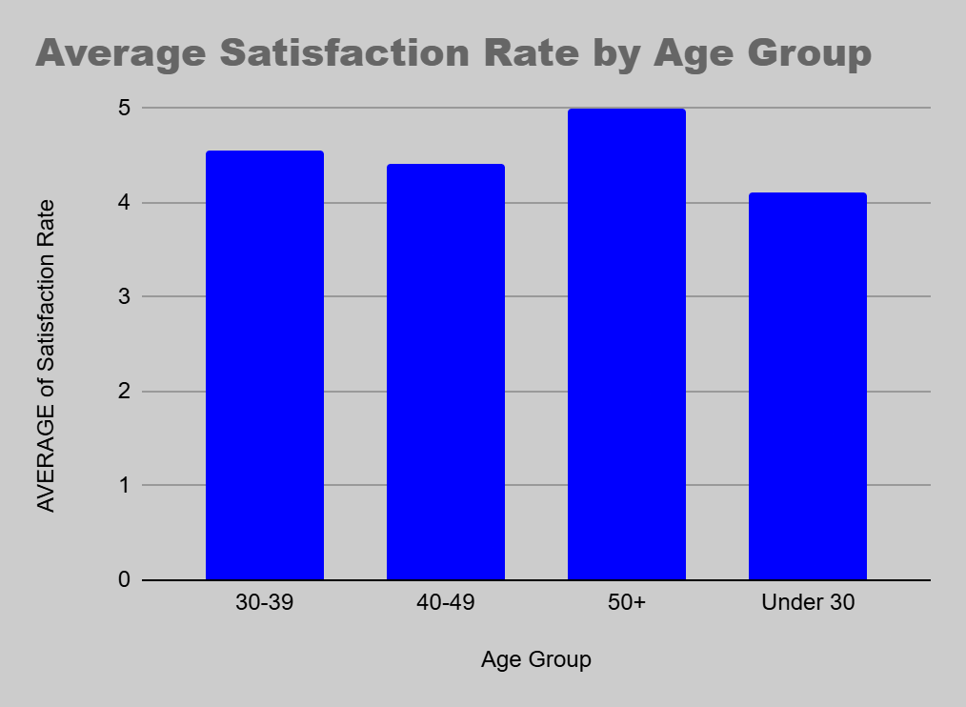
"Do workforce demographics influence satisfaction and performance outcomes?"
Workforce Demographics Analysis
Key Insights
Satisfaction ratings remain relatively consistent across age groups.
No significant performance differences are observed between age groups.
Employee satisfaction remains above 4.0 across the workforce.

Slide 15
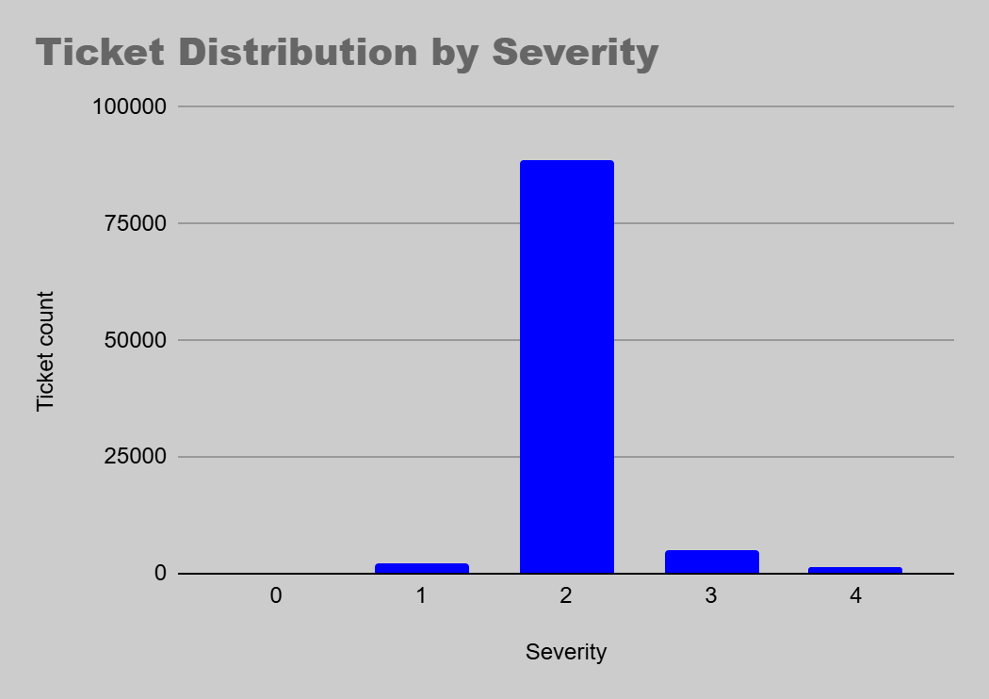
"Are operational challenges driven by a large number of critical issues?"
Severity & Service Quality Analysis
Key Insights
Most tickets fall under Severity Level 2.
High-severity tickets represent a smaller portion of the workload.
Operations primarily focus on moderate and recurring issues.

Slide 16
"What are the most important findings from the analysis?"
Key Business Insights
Insight 1
Insight 2
High Support Demand Concentration
Stable Customer Satisfaction
System and Login Access requests account for approximately 70% of all tickets, indicating that improvements in these areas can significantly reduce overall support workload.
Despite fluctuations in ticket volume, average satisfaction remains around 4.1/5, demonstrating consistent service quality.
Insight 3
Insight 4
Balanced Agent Workload
Technology Bottlenecks Identified
Ticket handling is evenly distributed among agents, with most agents resolving between 1,800 and 2,000 tickets.
Hardware and System issues require significantly longer resolution times than Login Access requests, indicating opportunities for process and technology improvements.

Slide 17
"What actions should the organization take to improve performance?"
Strategic Recommendations
Recommendation 1
Improve System Support Processes
Expected Impact
Reason : System-related requests account for 40% of total tickets.
Reduction in overall ticket volume and faster service delivery.
Recommendation 2
Invest in Hardware Troubleshooting Tools
Expected Impact
Reason : Hardware tickets require the longest average resolution time.
Reduced resolution time and increased support efficiency.
Recommendation 3
Targeted Agent Coaching
Expected Impact
Reason : A small number of agents show lower satisfaction ratings.
Improved customer experience and service consistency.
Recommendation 4
Workforce Planning Based on Trends
Expected Impact
Reason : Ticket volume follows recurring cyclical patterns.
Better staffing decisions during high-demand periods.

Slide 18
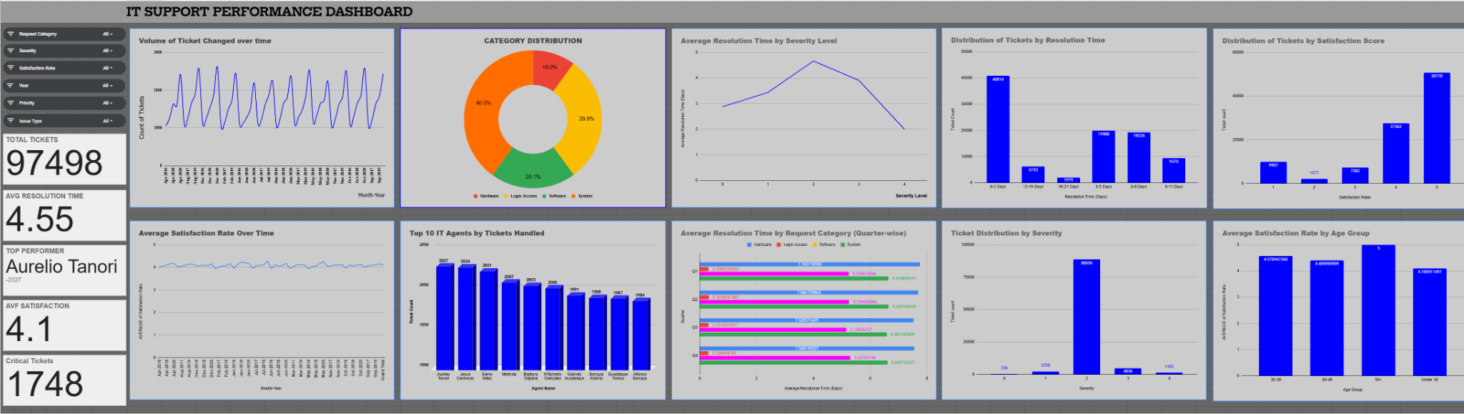
"How can management quickly monitor overall IT support performance?"
Full Dashboard

Slide 19
"How can management quickly monitor overall IT support performance?"
Key Highlights
Provides an executive-level summary of IT support performance.
Displays core operational KPIs and workload trends.
Highlights overall ticket demand and top-performing agents.
Tracks service quality and customer satisfaction trends.
Identifies request categories with longer resolution times.
Provides insights into ticket composition and workforce performance.
Provides deeper visibility into service quality and resolution performance.
Highlights workforce demographics and ticket handling patterns.
Supports continuous monitoring and performance optimization.
Interactive Dashboard
- Executive Overview

Slide 20
Closing Statement
The analysis indicates that improving technology and operational processes will deliver greater business value than increasing headcount, enabling faster ticket resolution, sustained employee satisfaction, and more efficient IT support operations.
Final Recommendation
✅ Prioritize technology upgrades, automation, and process improvements to reduce resolution times.
✅ Invest in targeted training and coaching for selected agents to improve customer satisfaction and service consistency.
✅ Continue monitoring key KPIs through the dashboard to support data-driven decision-making and continuous improvement.

Slide 21
"What is the final recommendation based on the analysis?"
Conclusion
The analysis successfully evaluated the performance of IT support operations using historical ticket data.
Major Findings
The IT support team handled 97,498 tickets while maintaining a strong average satisfaction score of approximately 4.1/5.
Ticket volume increased over time, but service quality remained stable, demonstrating effective operational performance.
Hardware and System requests consistently required the longest resolution times and represent the primary operational bottlenecks.
Workload distribution across agents is balanced, indicating that current staffing levels are generally sufficient.
Employee demographics showed minimal impact on satisfaction and ticket outcomes compared to operational and process-related factors.

Slide 22

Acknowledgements & References
THANK YOU
References
Project Dataset (Provided Dataset)
Google Sheets
Pivot Tables
Dashboard Visualizations
Spreadsheet Analytics Techniques
Acknowledgements
Special thanks to the project creators and mentors for providing the dataset, project framework, and analytical guidelines.

